Slide 1
A practical guide to using machine learning interatomic potentials
Case 1: https://colab.research.google.com/drive/1gp1ZIG_t05sY2iBbss75gB1pWtGcf21V?usp=sharing
Case 2: https://colab.research.google.com/drive/1B_y9wt-MD2ZC-aPwKwRl-Hsq89o3cIaX?usp=sharing
Case 3: https://colab.research.google.com/drive/1xgFtZ932eJ8C50CksSPjadhHdEklcrMT?usp=sharing
Case 4: https://colab.research.google.com/drive/1TIcba364wA4fMJGuhaH-8BaemPNr0PRJ?usp=sharing

Slide 2
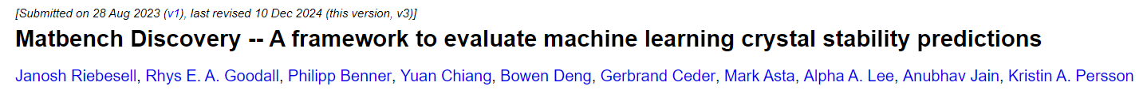
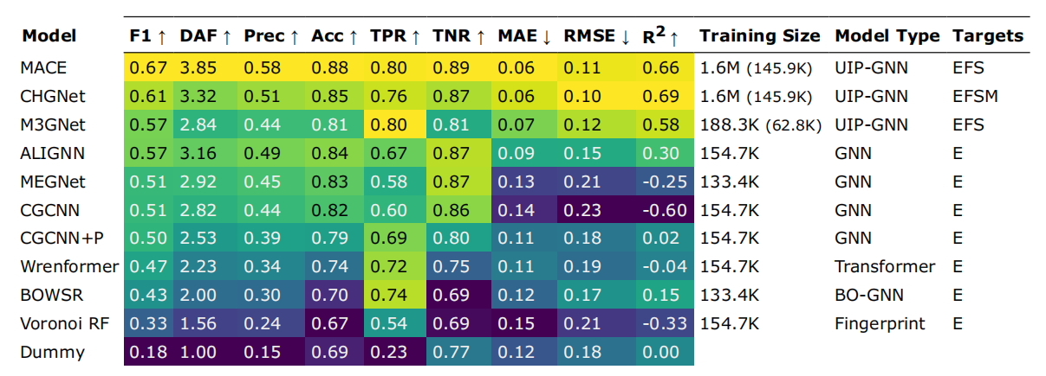
Matbench Discovery
The three universal machine learning interatomic potentials (uMLIPs)—MACE, CHGNet, and M3GNet—achieve the top three F1 scores.
arXiv preprint arXiv:2308.14920, 2023, Nat Mach Intell 7, 836–847 (2025)

Slide 3
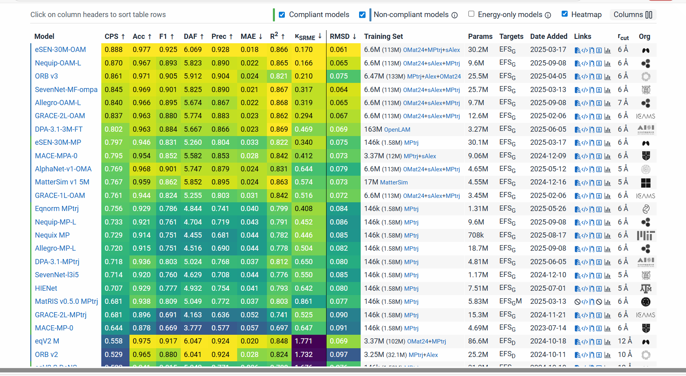
Matbench Discovery

Slide 4
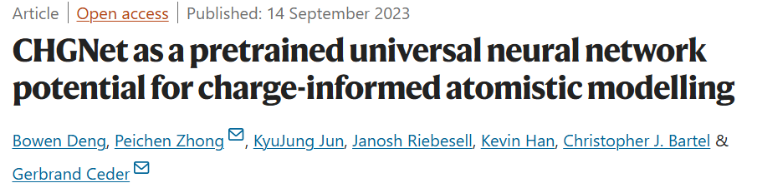
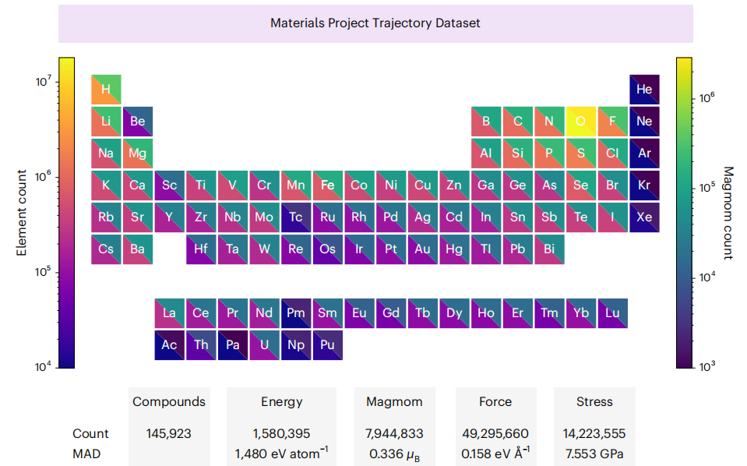
CHGNet
CHGNet is a MLIP model based on graph neural networks designed to model universal potential energy surfaces.
The training dataset, Materials Project Trajectory Dataset (MPtrj), comprises over 1.5 million DFT calculations of inorganic structures accumulated over more than a decade, including labels for energy, forces, stresses, and magnetic moments.
Incorporating magnetic moments during training enables CHGNet to effectively learn and accurately represent electron orbital occupancy, thereby enhancing its capability to describe both atomic and electronic degrees of freedom.
Nat Mach Intell 5, 1031–1041 (2023).

Slide 5
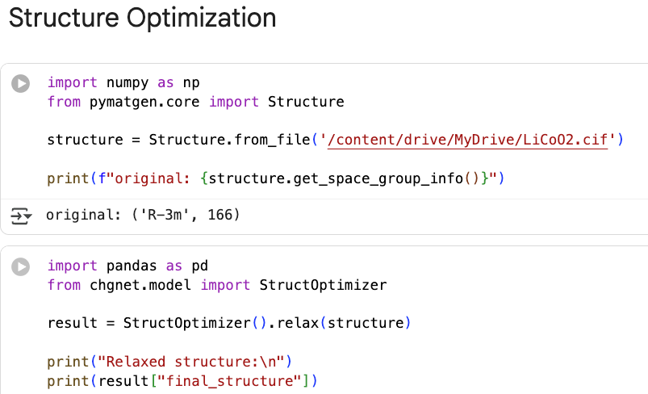
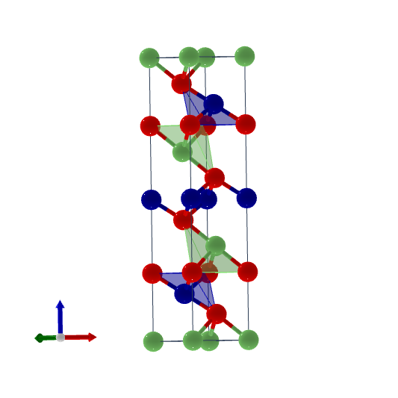
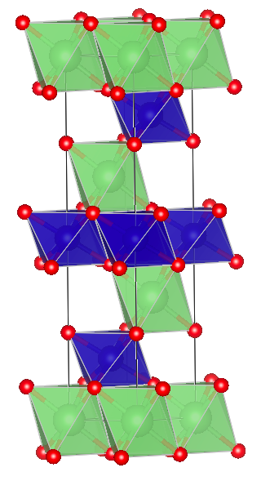
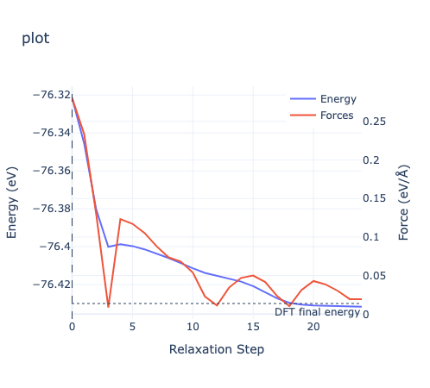
CHGNet：Structure Optimization
Structure Optimization by CHGNet

Slide 6
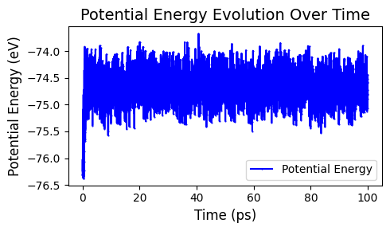
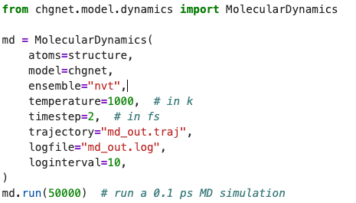
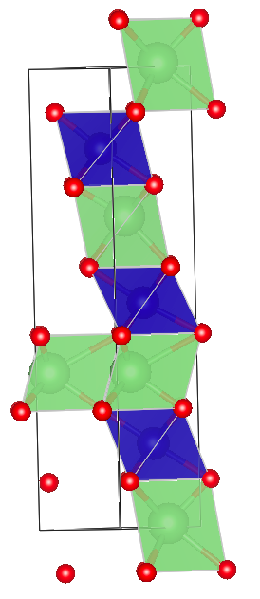
CHGNet：Molecular Dynamics

Slide 7
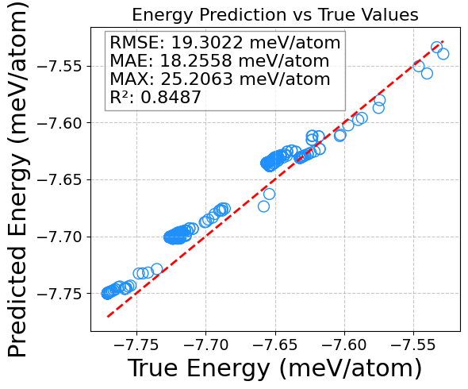
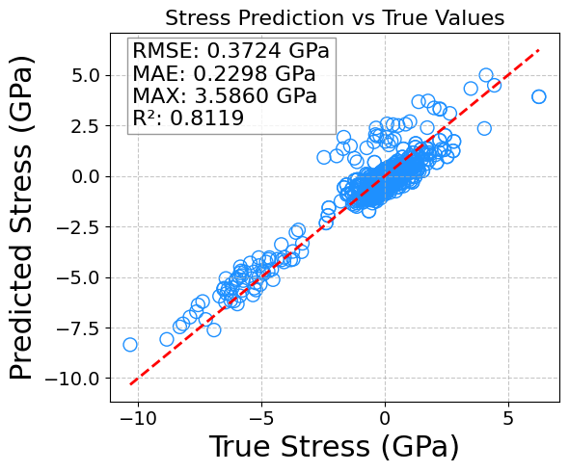
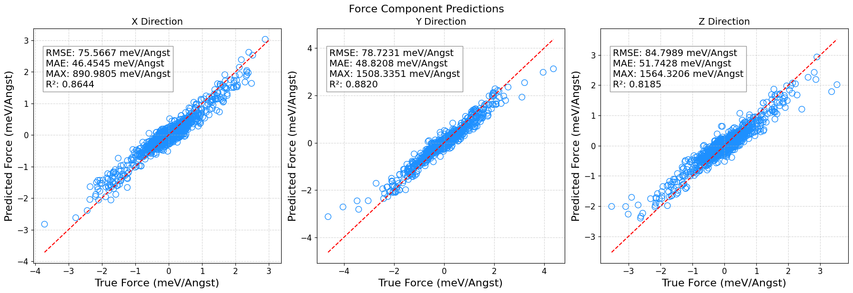
CHGNet：pertrained model
Energy
Stress
Force

Slide 8
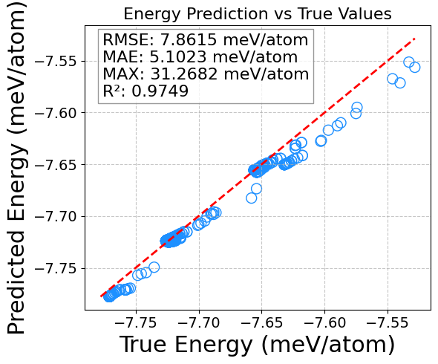
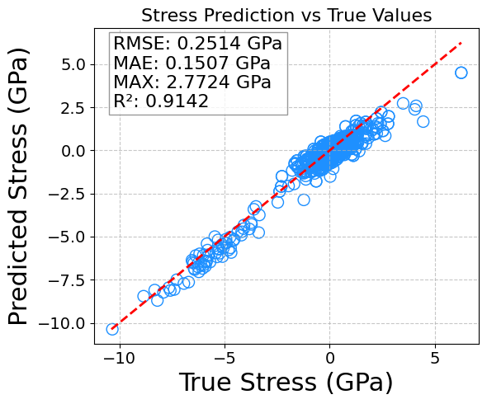
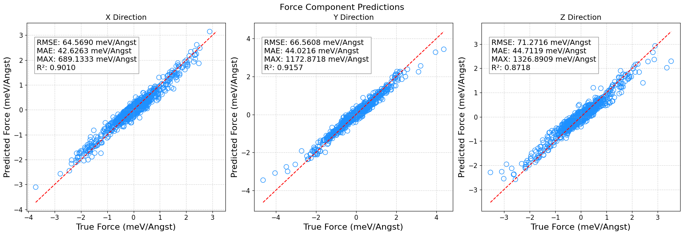
CHGNet：finetuned model
Energy
Stress
Force

